Slide 1


Exploratory Data Analysis of 1000 movies rated by IMDB
By – Akash Bhatt
INSAID COHORT BATCH 2nd MARCH 2019

Slide 2
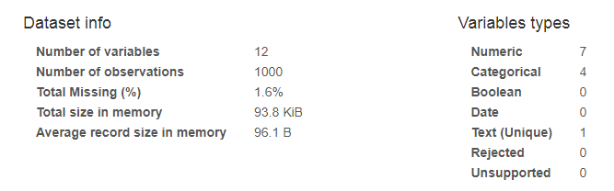
Overview
This dataset is 1,000 most popular movies on IMDB in the last 10 years(2006-2016). Various variables present in the dataset includes data of Title, Genre, Description, Director, Actors, Year, Runtime, Rating, Votes, Revenue, Metascrore.

Slide 3
Problem Statement
What kind of movies should be produced in the film industry to be successful?
Hypothesis: Movies in Action genre will be liked by most of the people.

Slide 4
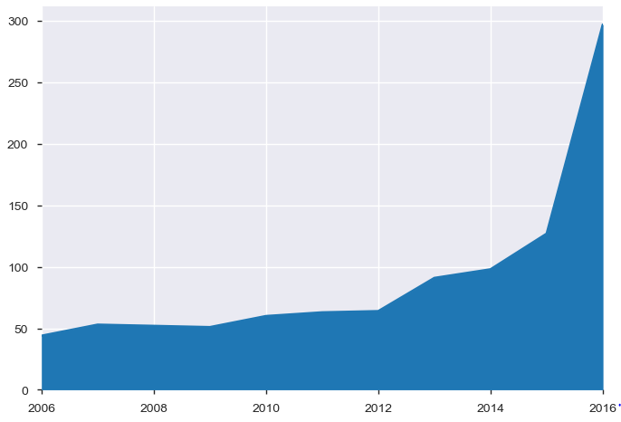
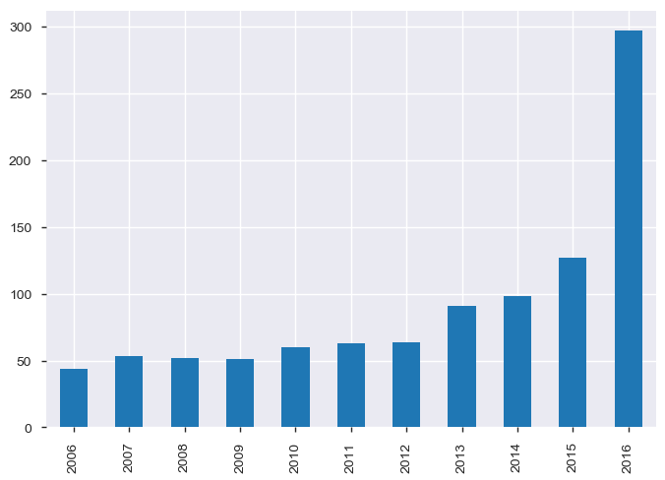
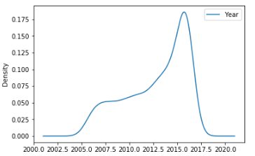
Frequency of movies released vs Years
Area Graph Histogram
Most of the movies were released in 2016 and very few movies were released in or before 2006.

Slide 5
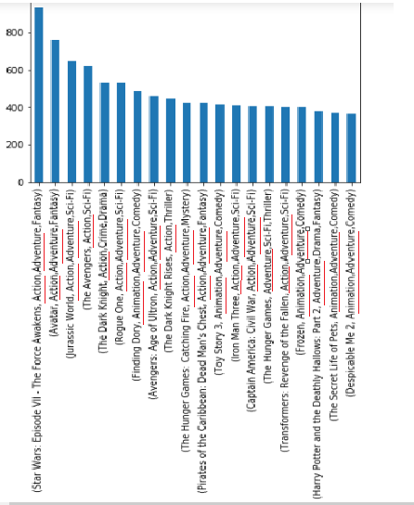
Top 10 movies(Revenue) vs Common Genres
Almost all the movies had genres like :
Action
Adventure
Animation

Slide 6
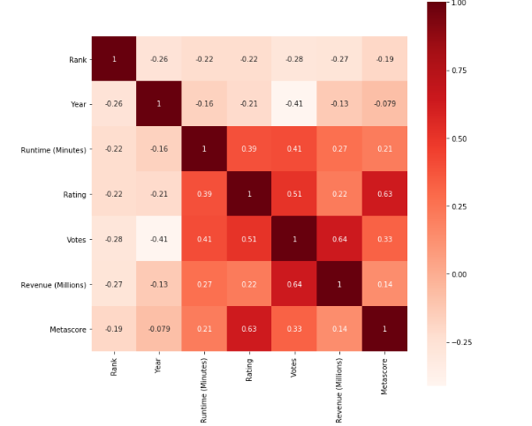
Heatmap - Correlation among various columns
Rating and Metascore are highly correlated
Rating vs Votes / Rating vs Runtime are also correlated.

Slide 7
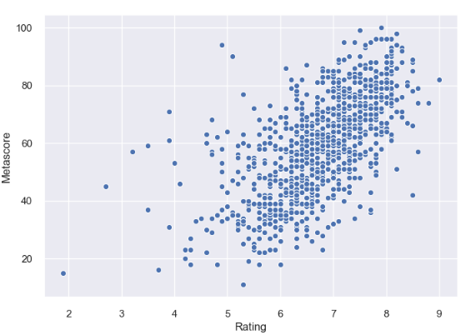
Metascore Vs Rating (ScatterPlot)
Rating between 6-7 have Metascore between 40-60
Rating between 7-8 have Metascore between 60-80
Very few movies having Rating between 8-9 and metascore >80

Slide 8
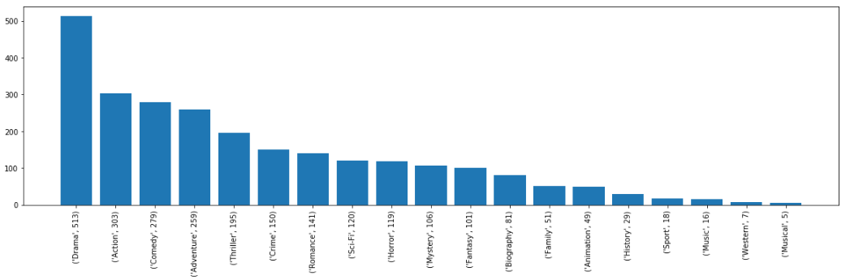
Out of 1000 movies , the most common genre were:
Drama (in 513 movies)
Action (in 303 movies)
Comedy (in 279 movies)

Slide 9
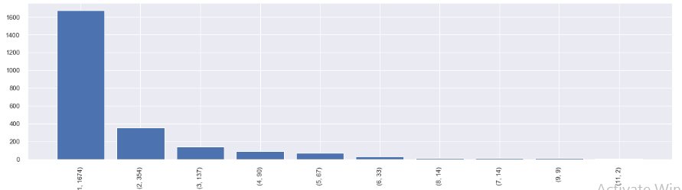
No. of movies vs No. of actors
Y axis represents the number of movies
X axis represent (No. of movies starred in , No. of actors )
1674 actors starred in only 1 movie
Only 2 actors starred in 11 movies.

Slide 10
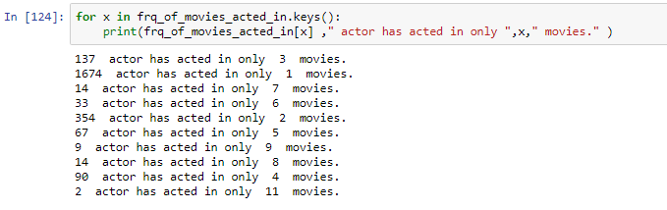
Christian Bale and Mark Wahlberg are the two celebrities who have starred in 11 movies between 2006 – 2016.

Slide 11
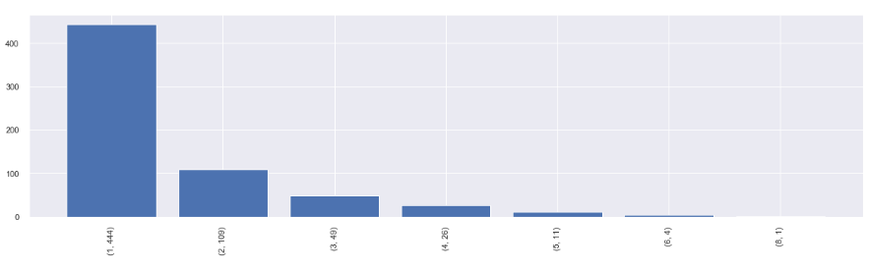
No. of Movies vs No. of Directors
Y axis represents the number of movies
X axis represent (No. of movies directed , No. of Directors)
444 directors directed only 1 movie
Only 1 director directed in 8 movies.

Slide 12
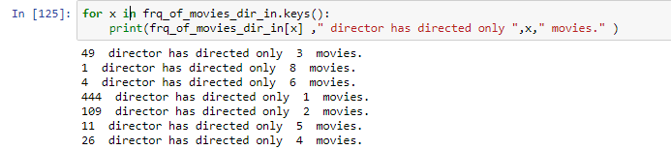
Ridley Scott is the only director who has directed 8 movies between year 2006 - 2016

Slide 13
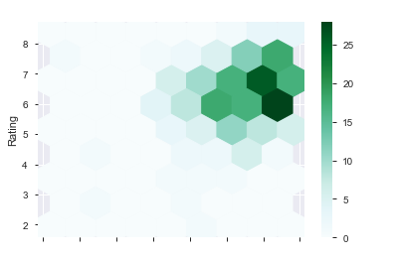
Runtime(Minutes) vs Rating
Movies with runtime between 60 to 100 minutes has avg rating between 5.5 to 7

Slide 14
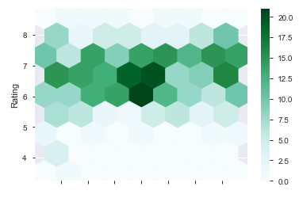
Runtime(Minutes) vs Rating
Movies with runtime between 100 to 120 minutes has avg rating between 5.5 to 7.5

Slide 15
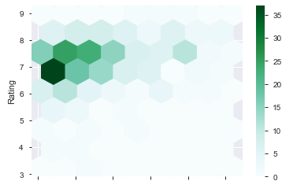
Runtime(Minutes) vs Rating
Movies with runtime between 120 to 180 minutes has avg rating between 6.5 to 8

Slide 16
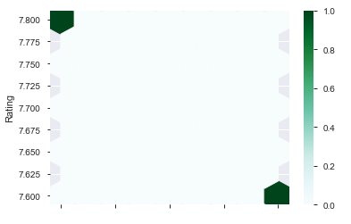
Runtime(Minutes) vs Rating
Movies with runtime between 180 to 200 minutes has avg rating between 7.6 to 7.8

Slide 17
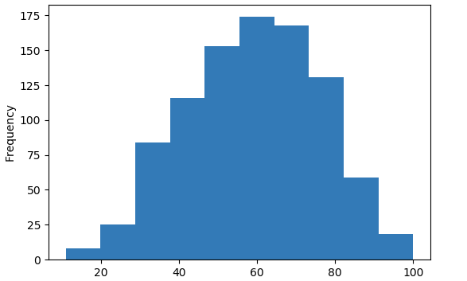
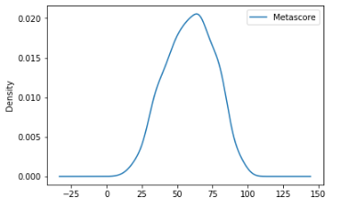
Metascore
Most of the movies have metascore between 60-75
It is lepokurtic

Slide 18
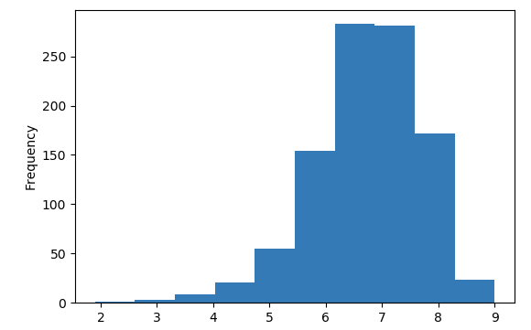
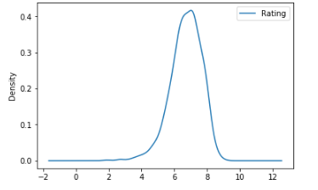
Rating
Most of the movies have rating between 6.5 and 8
It is left skewed
The density function is also Lepokurtic

Slide 19
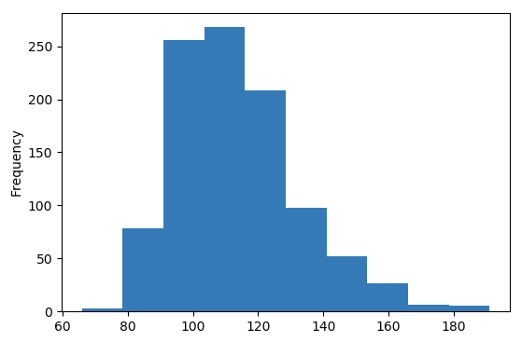
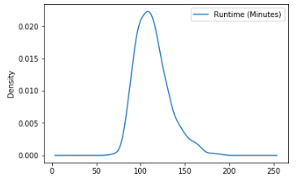
Runtime(Minutes)
Most of the movies have the run time between 100-130 minutes
The Density function is Lepokurtic .

Slide 20
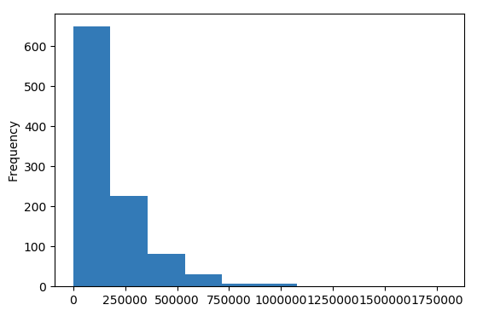
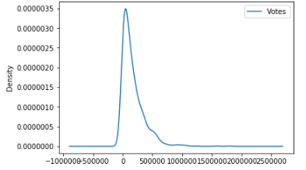
Votes
Most of the movies have votes between 0 to 20000
The Density function is Lepokurtic .
It is also Right skewed.

Slide 21
Conclusion
Action ,Adventure and Animation are the most liked genres by people.
Between 2006 -2016, most no. of movies were released in 2016
.Movies with runtime:
60-100 mins. has avg Rating between 5.5 – 7
100-120 mins. has avg Rating between 5.5 – 7.5
120-180 mins. has avg Rating between 6.5 - 8
>180 mins has avg Rating between 7.6 - 7.8
Most of the movies have Metascore between 60 - 75
Most of movies have runtime between 100 – 130 mins.
Most of the movies have votes between 0 to 20000.
Most of the actors (1674) have acted in only 1 movie.
Only 2 actors starred in 11 movies.
Only 1 director directed 8 movies
Most of the directors (444) have directed only one movie.

